Slide 1
Connect Four
By Eric Smith, Sriman Badhri, Lawrence Stephenson, Trung Le

Slide 2
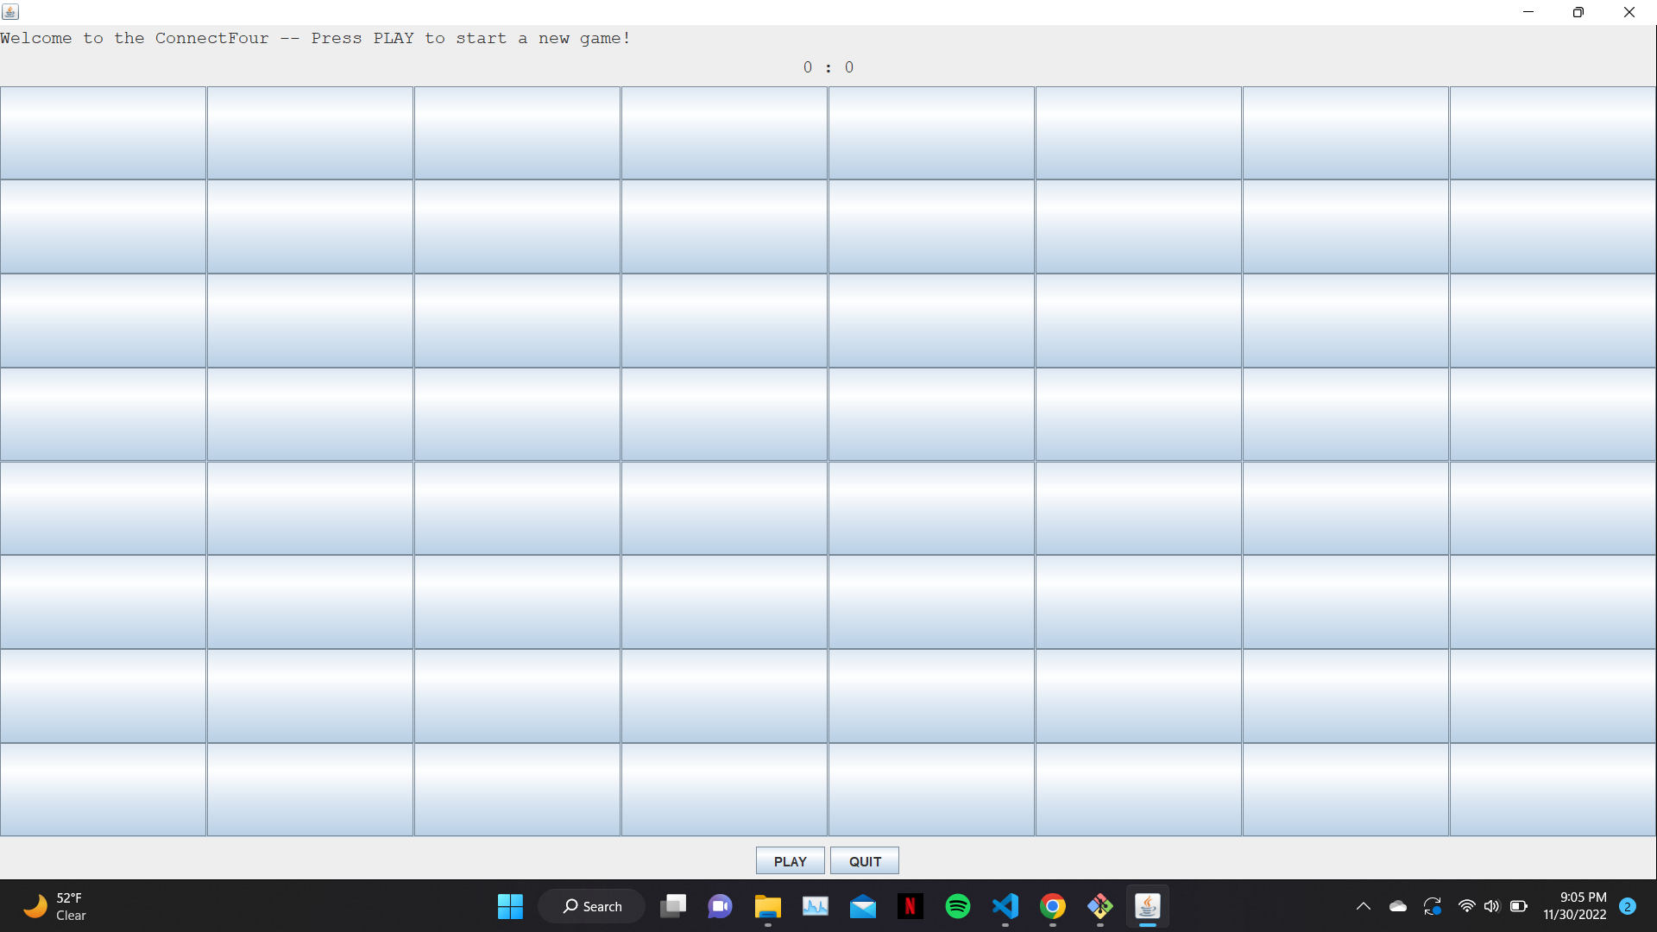
Description of Project
Connect Four but with the ability to choose how many pieces are required to be connected to win
Grid updates based on number of pieces needed to win
Displays how many times each player wins is tracked

Slide 3
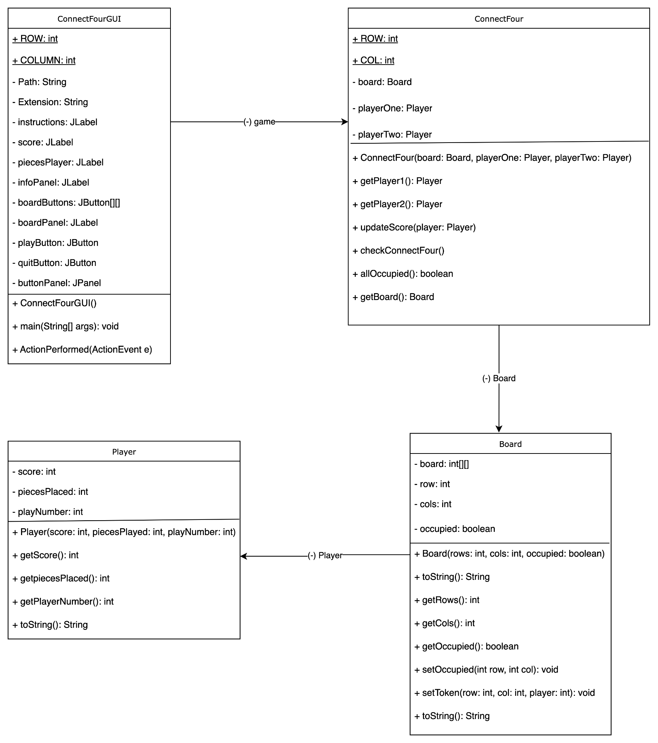
Design Options
Design Option 1
Pros: Straight forward,
Easy to access data
Cons: not very detailed,
May need to add
Additional methods

Slide 4
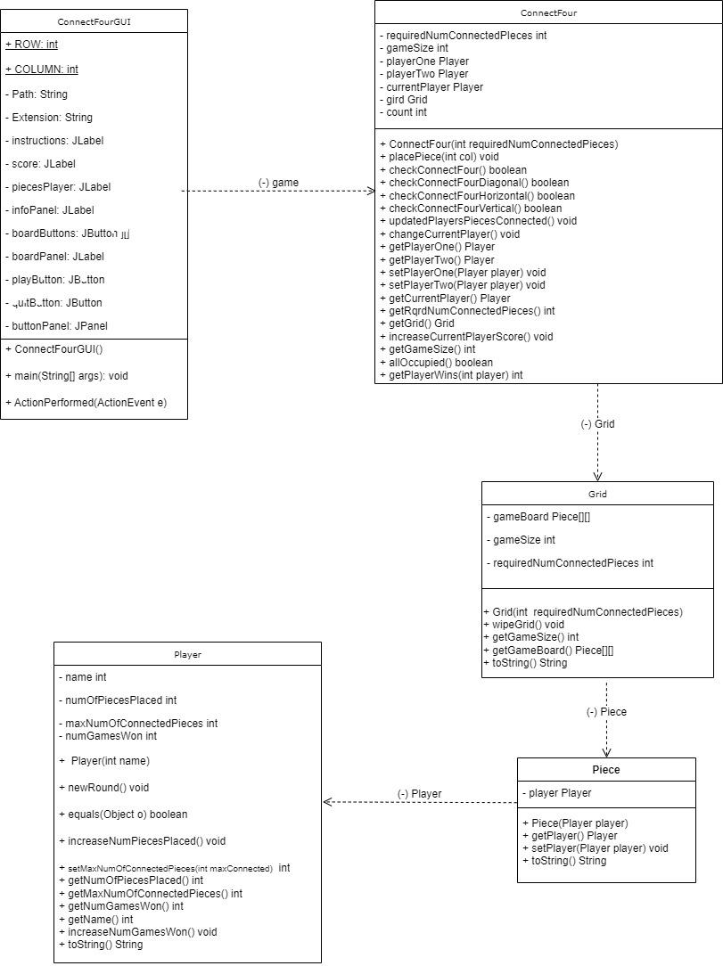
Design Options
Design Option 2
Pros: Good coverage, Keeps track
Of information better
Cons: Complicated, possible
redundancies

Slide 5
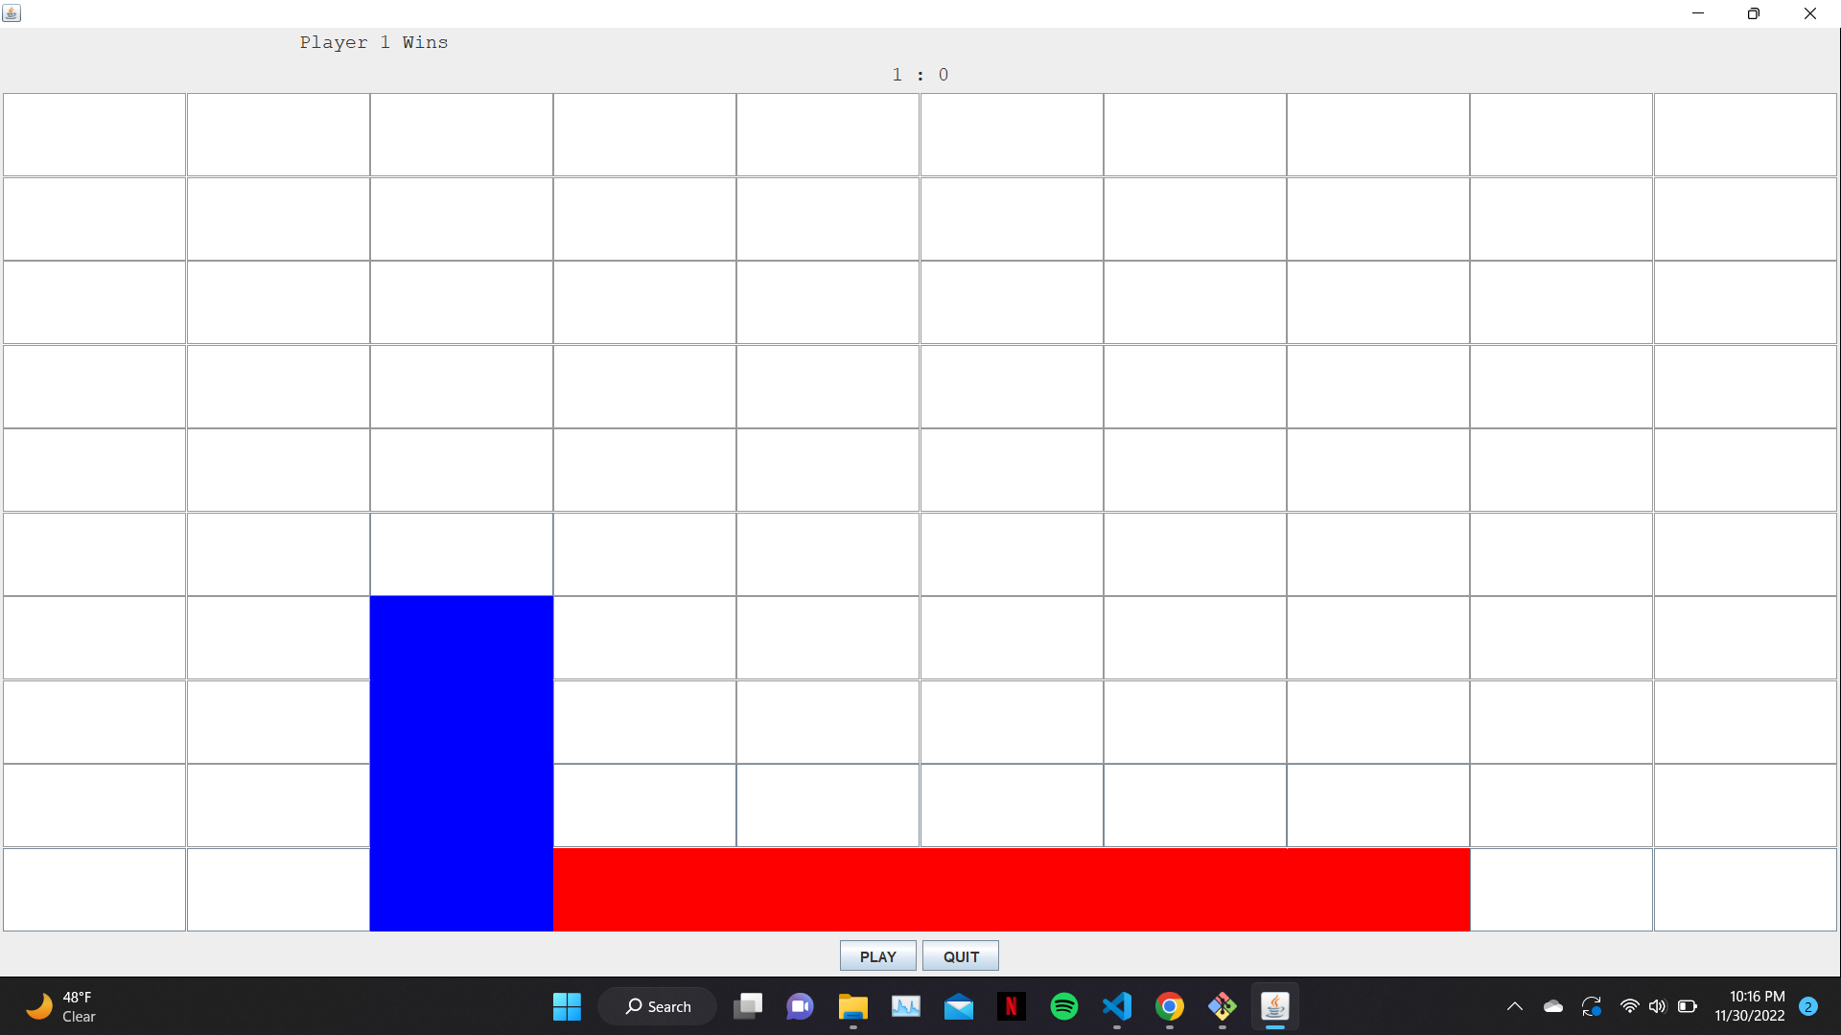
Test Cases
Tested every possible outcome of a game of connect four
- Horizontal win
- Vertical win
- Diagonal win \
- Alternative Diagonal win /
- tie
- Tested game where number of pieces needed to win was not four

Slide 6
DEMO TIME!

Slide 7

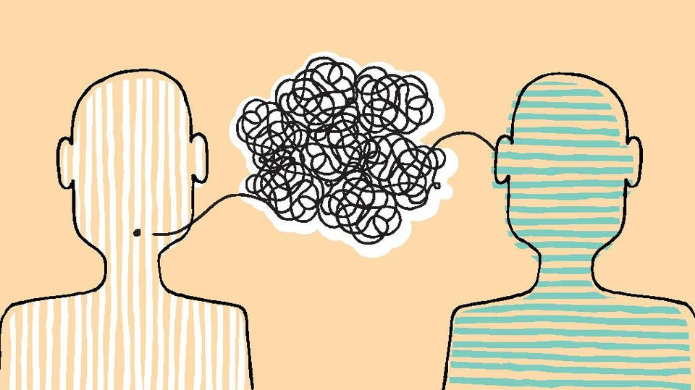
Lessons Learned
Design and requirements is really hard
Communication is essential
Notes:
Lesson Learned 1: Design and requirements is really hard. It was very difficult to predict everything that we would need to get the project done and we found ourselves having to add and change things to our design.
Lesson Learned 2: Communication is essential. We created a group chat but unfortunately one member was not included so over the break two different implementations of the project were created. We then needed to coordinate to combine those two implementations.

